Slide 1

Design Encryption and Decryption scheme for modes of operation on Advanced Encryption Standard (AES-128) in verilog
Supervisor – Dr. NS Rajput sir
Members – Pranav Mittal 19095076

Slide 2
TIMELINE- 2021
January
Learning basics of Digital Electronics from the book DIGITAL DESIGN by Morris Mano
Writing code for some basic circuits like Ripple 4-bit adder, D-flipflop
Clock-divider etc
Feb-March
April
1)Solving the problem statement
2)Encountering all the problems
3)Final verification of solved problem statement and preparing for
the project presentation

Slide 3
CONTENTS
ABSTRACT
PROJECT DETAILS
IMPLEMENTATION
PROBLEMS FACED DURING IMPLEMENTATION
Key Expansion
Implementing Mix Columns
FUTURE ENDEAVURES
REFERENCES

Slide 4
ABSTRACT
As the number of applications of IOT and wireless communication arises, the need of encryption algorithms increases which are fast and secure (as the hardware has to limited) and also to remove errors during communication. Manufacturers know that encryption must be the silver bullet to protect their products and customers.

Slide 5
PROJECT DETAILS
To code ,we have used a sample image that has been encoded to bitstream of 128 bit using python code . This bitstream is encoded using following modes.
1) Electronic Code Book Mode
2) Cipher Block Chaining Mode
3) Cipher Feedback Mode
4) Output Feedback Mode
Then it is decoded and the bits are converted to image using python code.

Slide 6
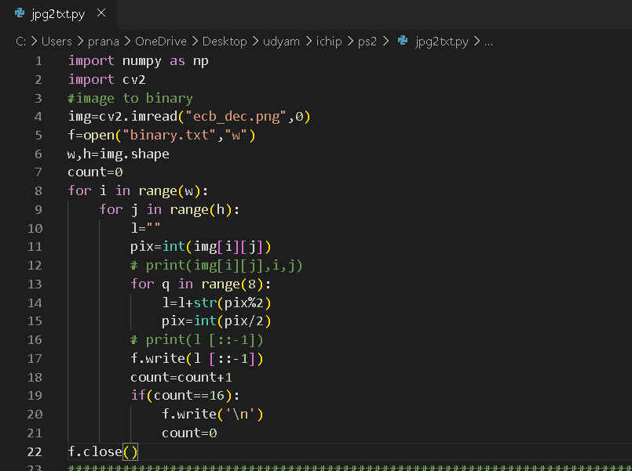
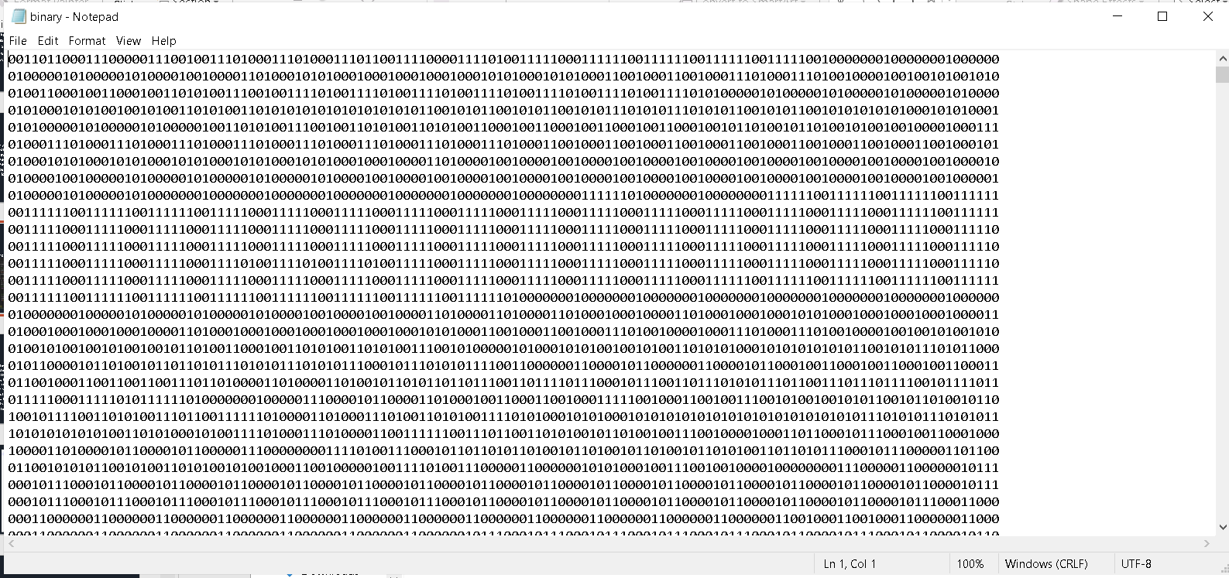
IMPLEMENTATION
Encoding of Pixels to binary bits and writing to a file

Slide 7
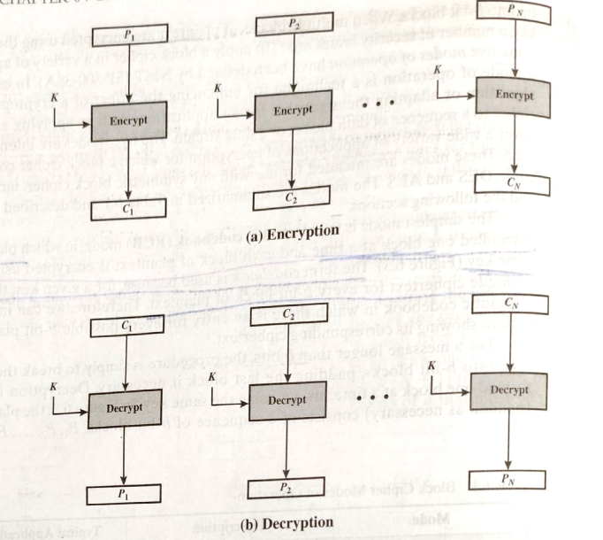
ECB Mode Electronic CodeBlock
A key is Xor-ed with text to generate cipher.
Doing this again returns us the plain text.

Slide 8
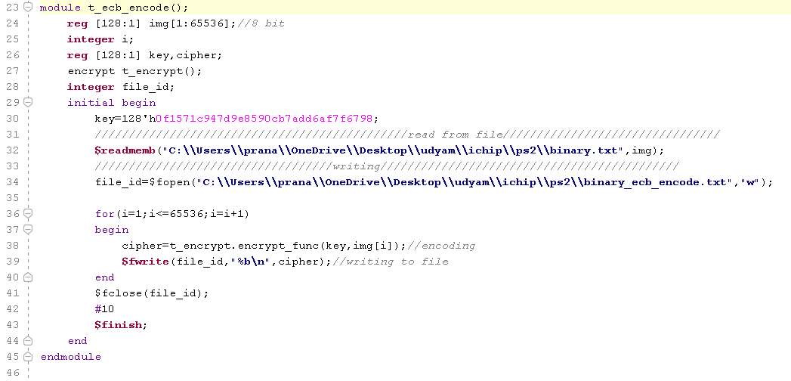

Slide 9
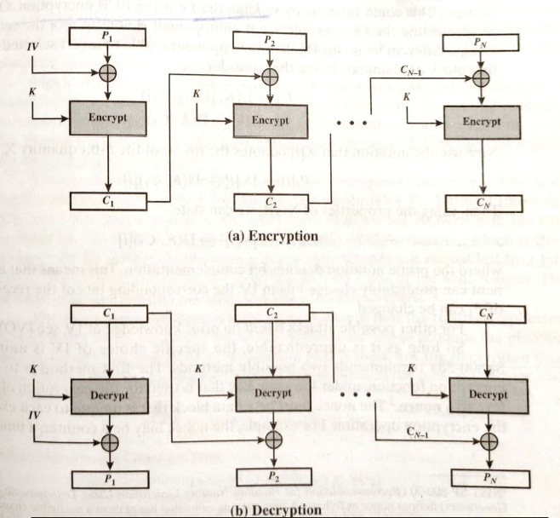
CBC Mode Cipher Block Chaining
Input to the encryption algo is the Xor of the next 128 bit plaintext and the preceding 128 bit of cipher text.

Slide 10
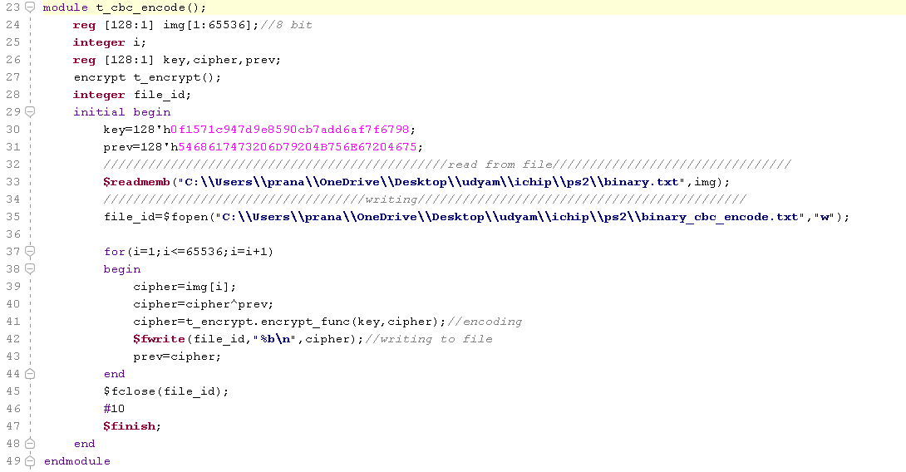

Slide 11
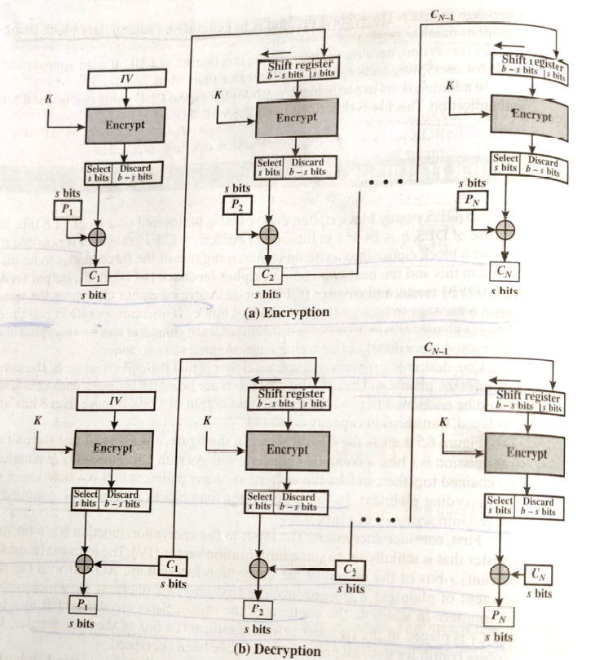
CFB Mode Cipher CodeBlock
Input is processed s bits at a time. Preceding ciphertext is used as input to the encryption algorithm to produce pseudorandom output, which is Xored with plaintext to produce next unit od ciphertext.

Slide 12
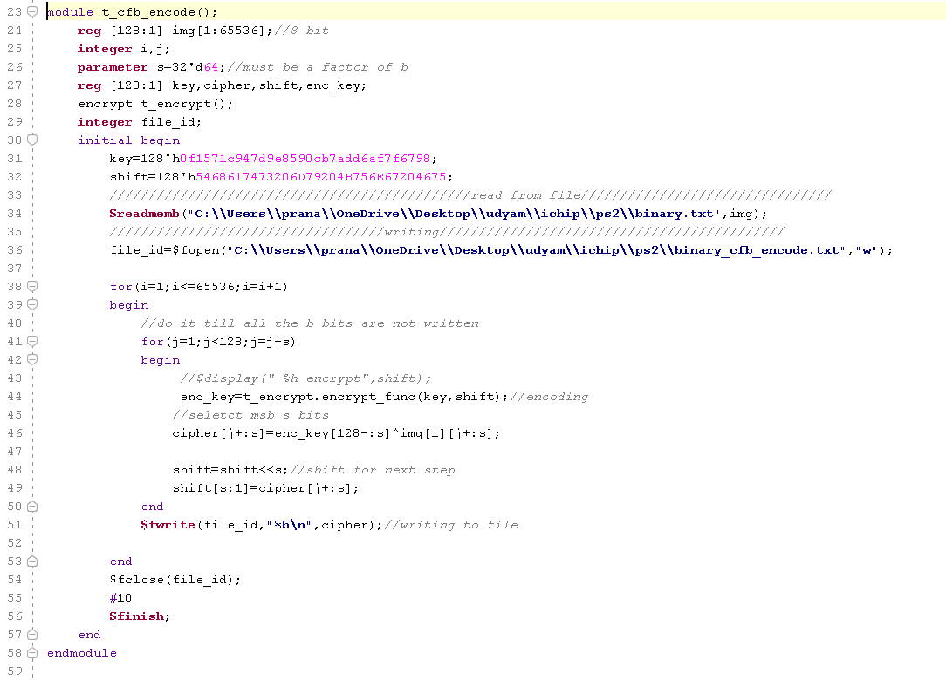

Slide 13
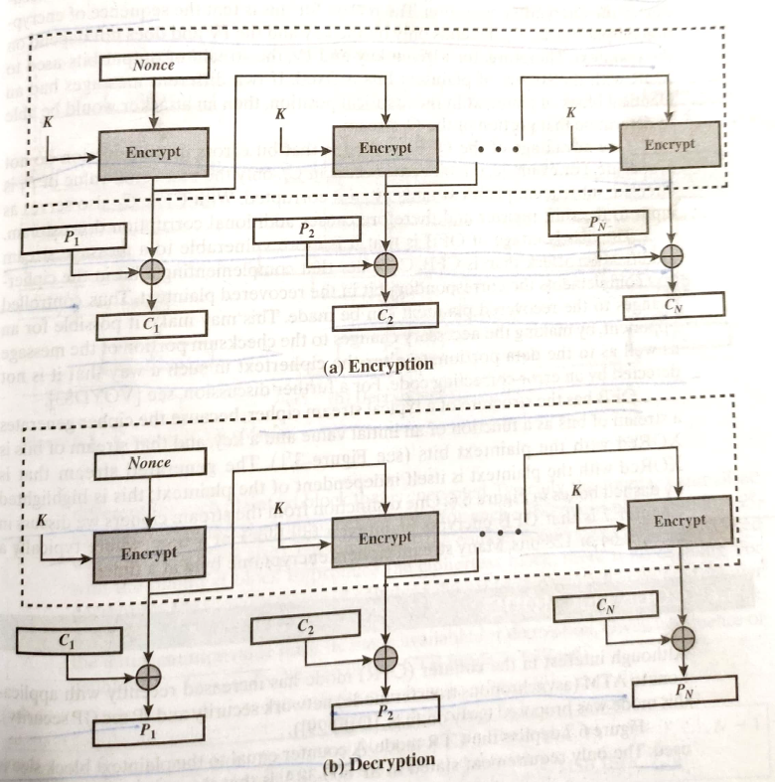
OFB Mode Output Feedback
Similar to CFB, except that input to encryption algorithm is the preceding encryption output, and full blocks are used.

Slide 14
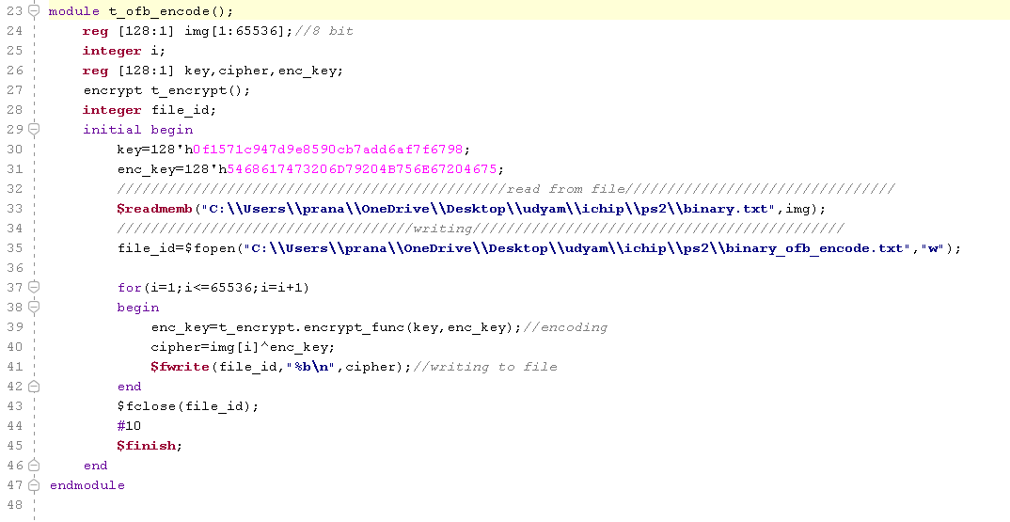

Slide 15
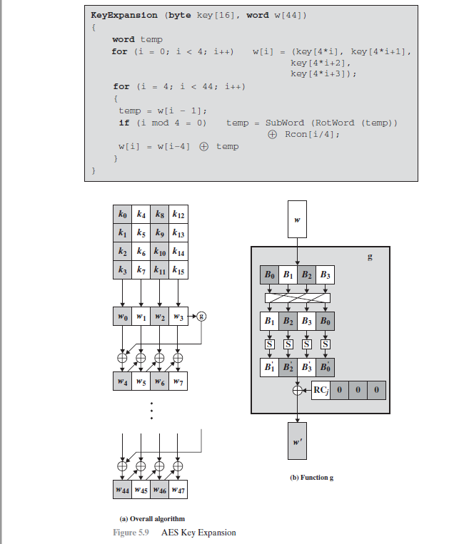
Key Expansion
The AES key expansion algorithm takes as input a four-word (16-byte) key and produces a linear array of 44 words (176 bytes).

Slide 16
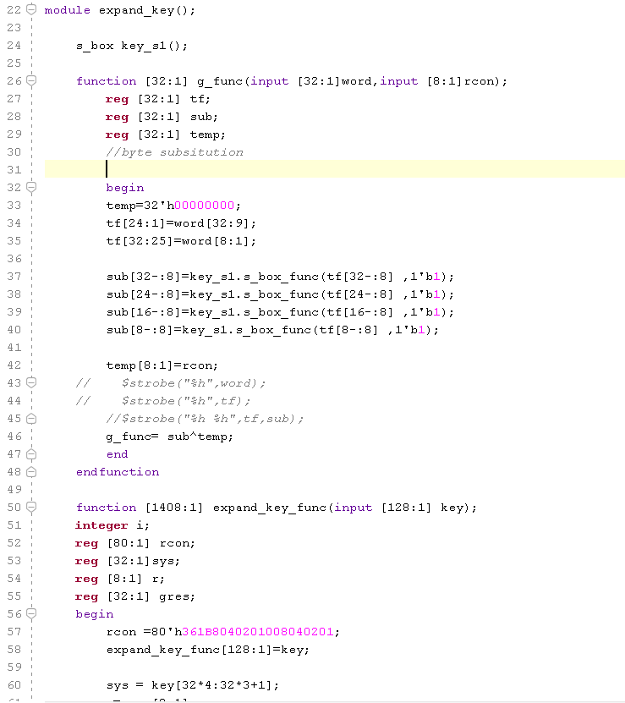
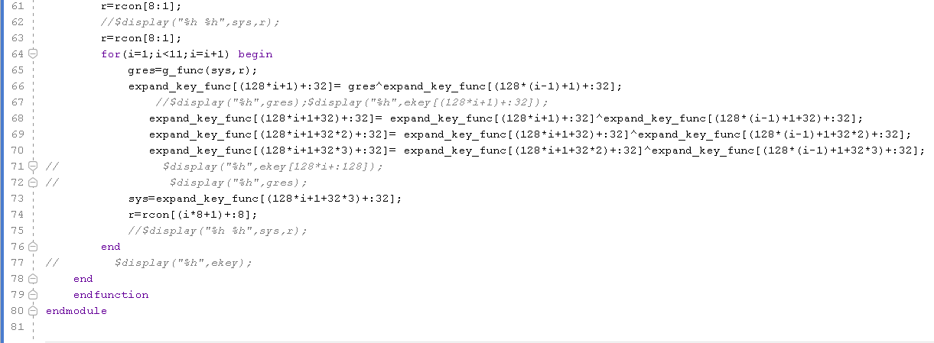
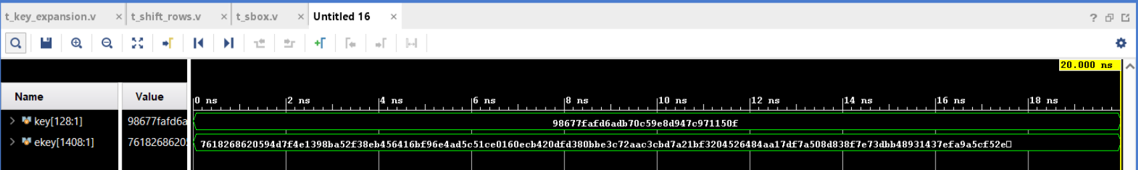

Slide 17
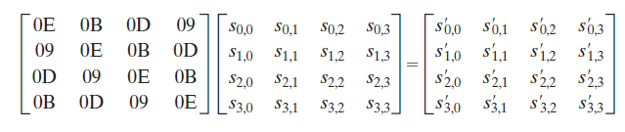
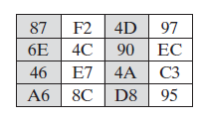
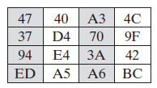
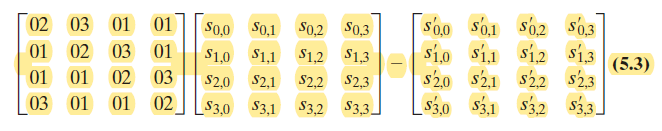
Mix Columns
Decrypt
Encrypt

Slide 18
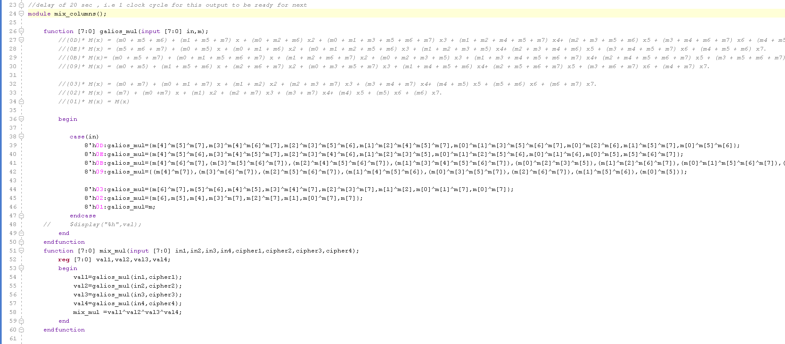
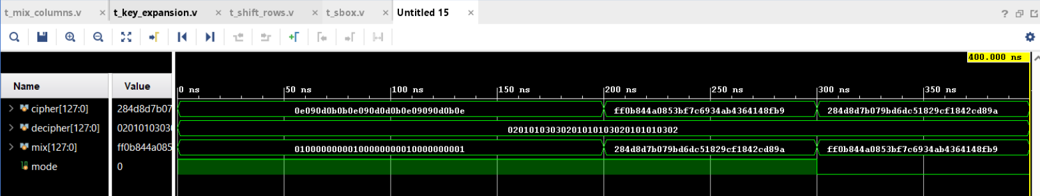

Slide 19
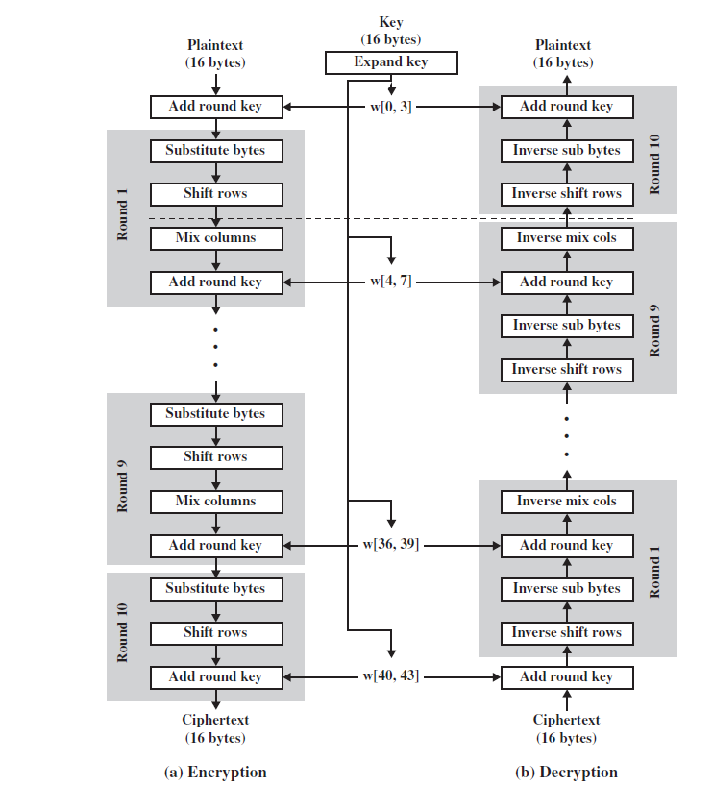
Overall Encryption
Other modules implemented :
S-Box
Shift Rows

Slide 20
FUTURE ENDEAVOURS
To design RTL model for the code written and increasing the THROUGHPUT
Using the same architecture for 64 bit and 32 bit cipher text.

Slide 21
REFERENCES
Digital design 4th edition by Morris Mano
AES structure
Chapter 5,Crytography And Network Security By William
Stallings
GALOIS FIELD MULTIPLICATION
https://arxiv.org/ftp/arxiv/papers/1209/1209.3061.pdf

Slide 22
THANK YOU

